Slide 1

Working on Titanic Dataset
- Efforts by Anshul Aggarwal

Slide 2
RMS Titanic was a British passenger liner operated by the White Star Line that sank in the North Atlantic Ocean, after striking an iceberg during her maiden voyage from Southampton to New York City. It was the largest ship afloat at the time she entered service. After leaving Southampton on 10 April 1912, Titanic called at Cherbourg in France and Queenstown (now Cobh) in Ireland, before heading west to New York.
The collision caused the hull plates to buckle inwards along her starboard (right) side and opened five of her sixteen watertight compartments to the sea. Passengers and some crew members were evacuated in lifeboats, many of which were launched only partially loaded. A disproportionate number of men were left aboard because of a "women and children first" protocol for loading lifeboats.

Slide 3
Objective
To find the complete analysis of what sorts of people were likely to survive the shipwreck. So through the tools of machine learning, which passengers survived the tragedy has to be predicted.
The Purpose of this project is to document the process to create predictions for Titanic Survivor Prediction.
The Objective of this project was to build a classification model that could successfully determine whether a Titanic passenger lived or died.

Slide 4
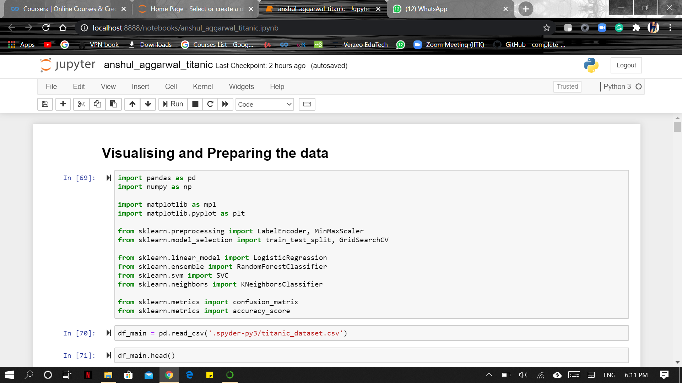


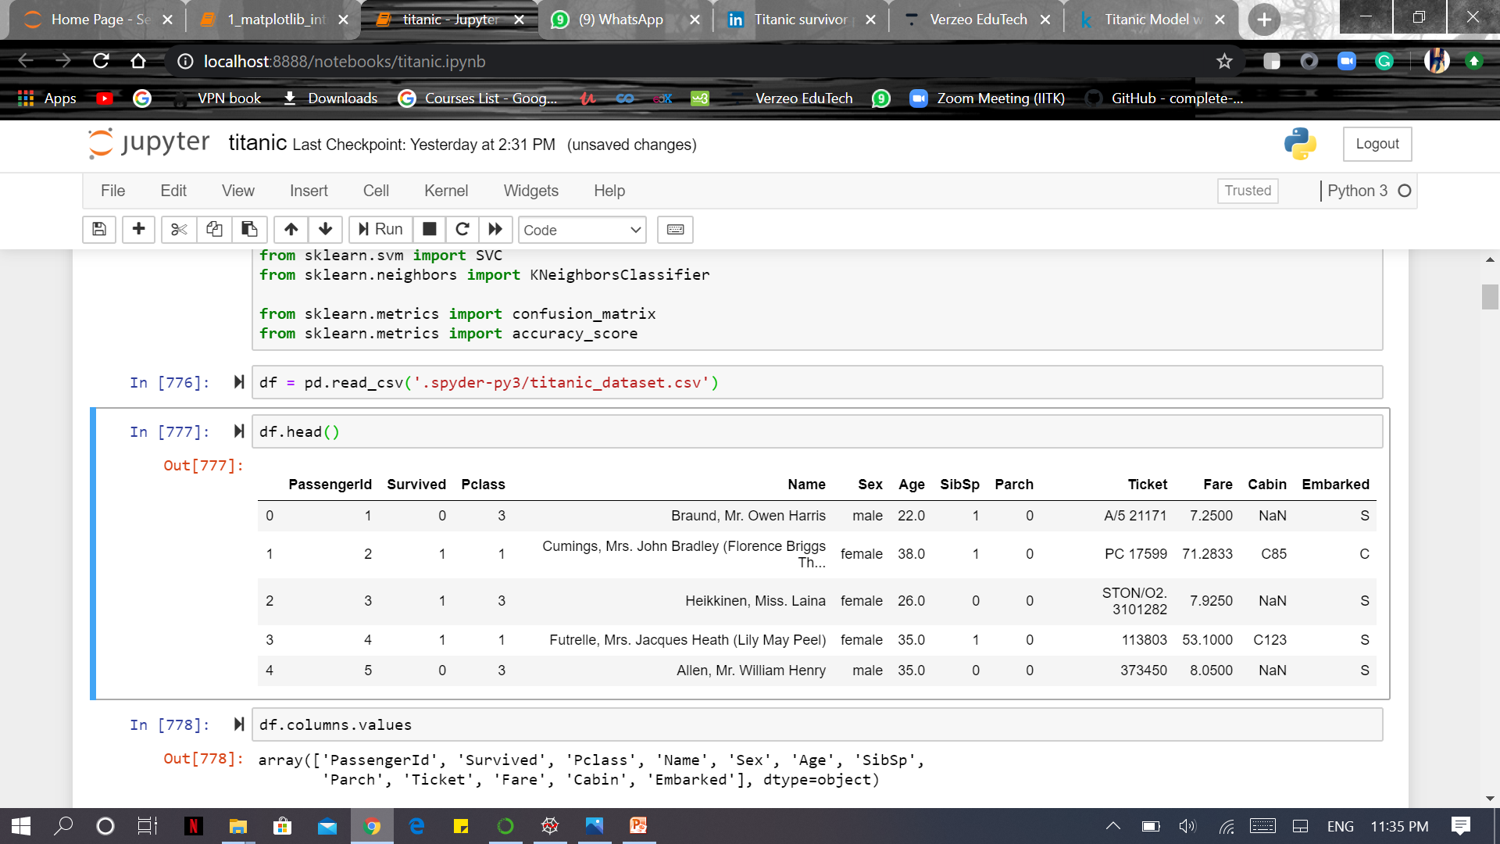
First Step – Importing useful libraries and the dataset
Importing Libraries
Imported
Dataset

Slide 5
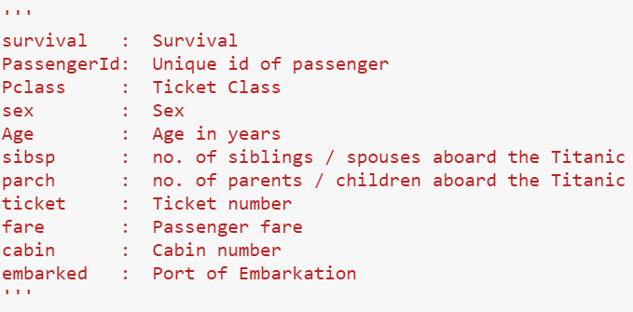
Second Step – Visualizing and Preparing the data
In the dataset we are provided with different features which contribute to the survival of the people i.e. the target value

Slide 6
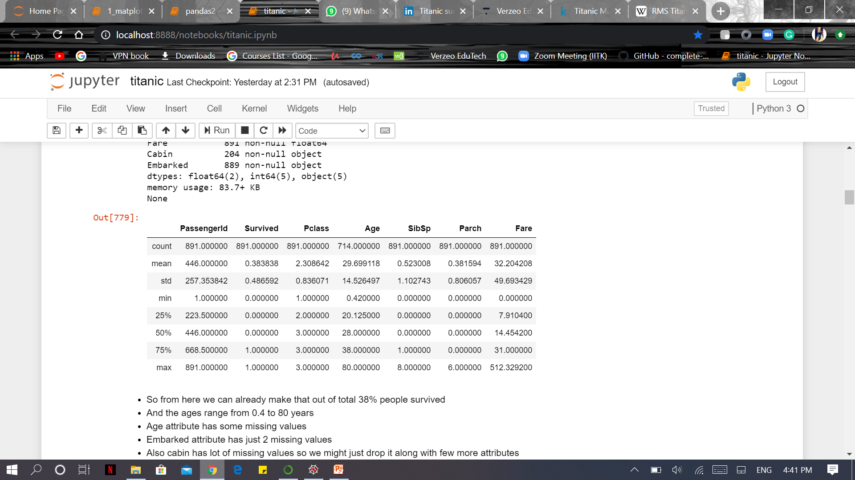
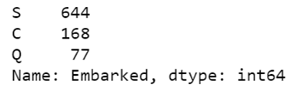
- Exploring some details about the dataset

Slide 7
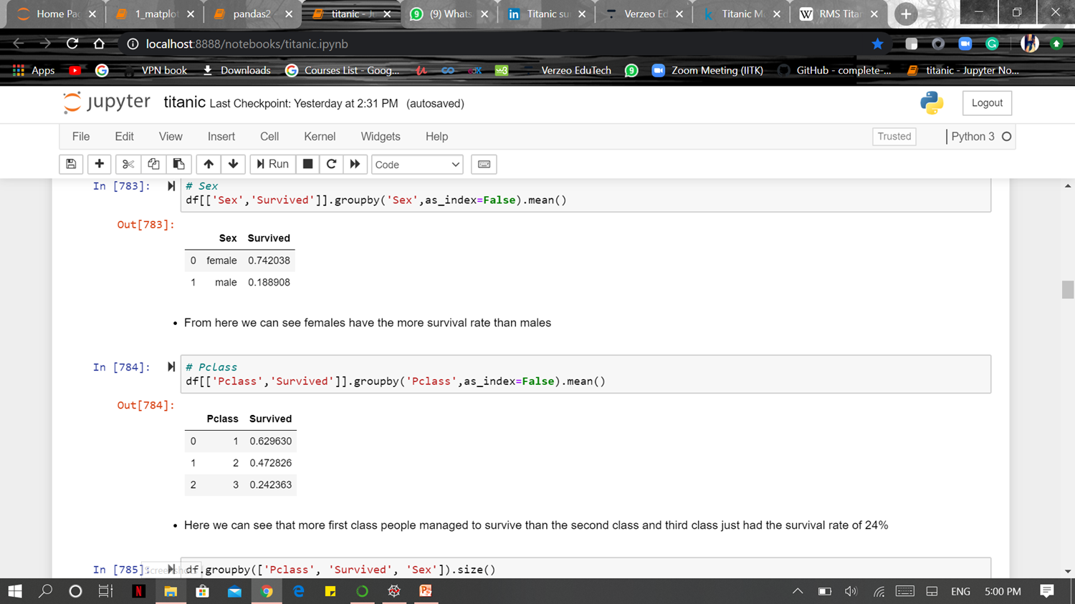
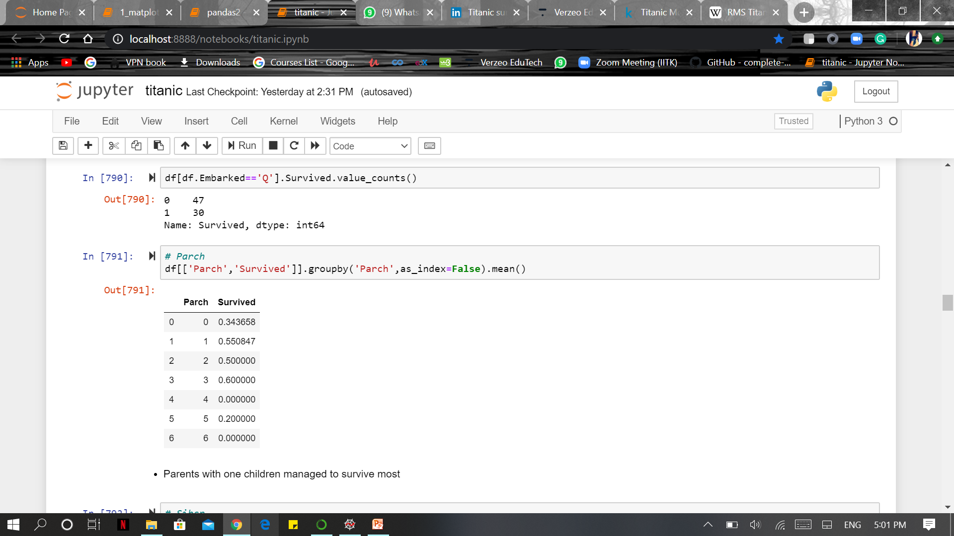
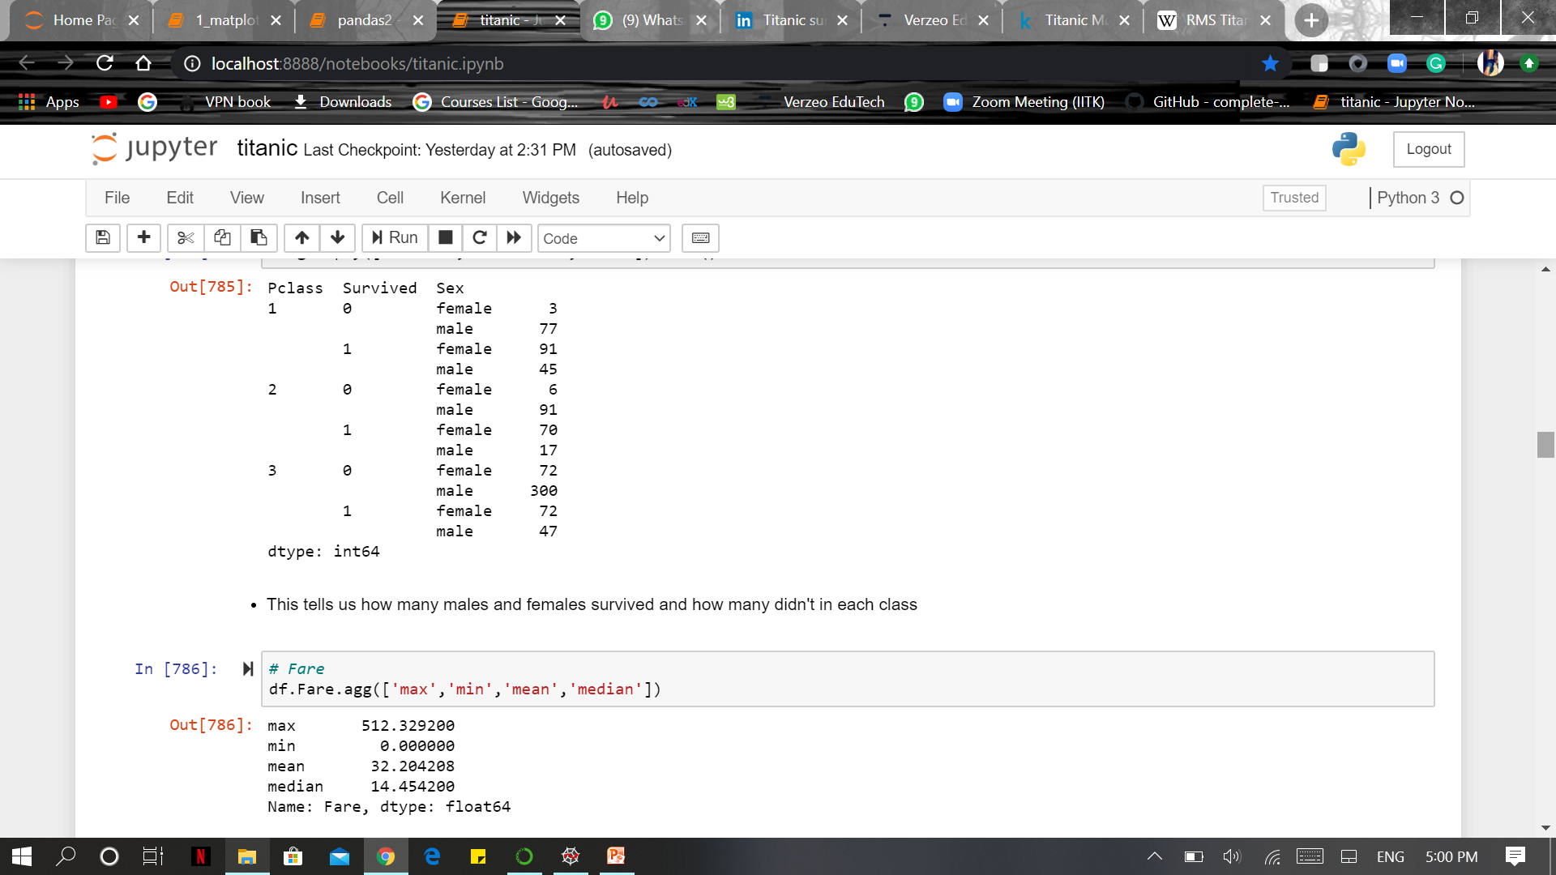
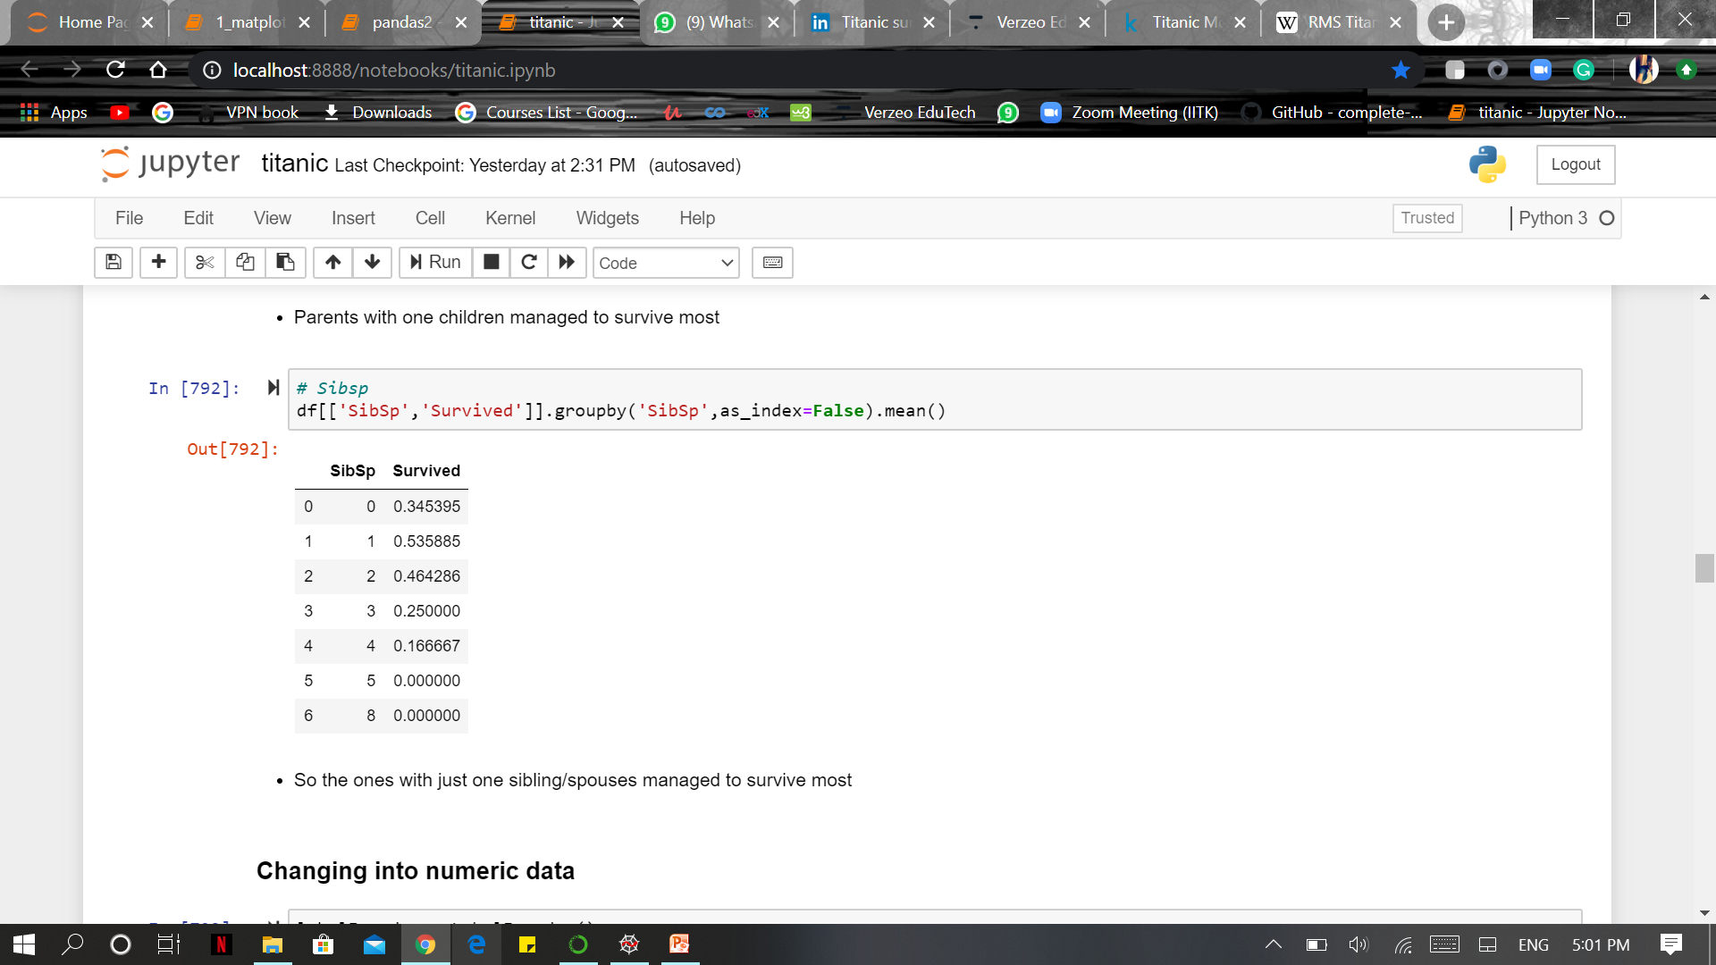
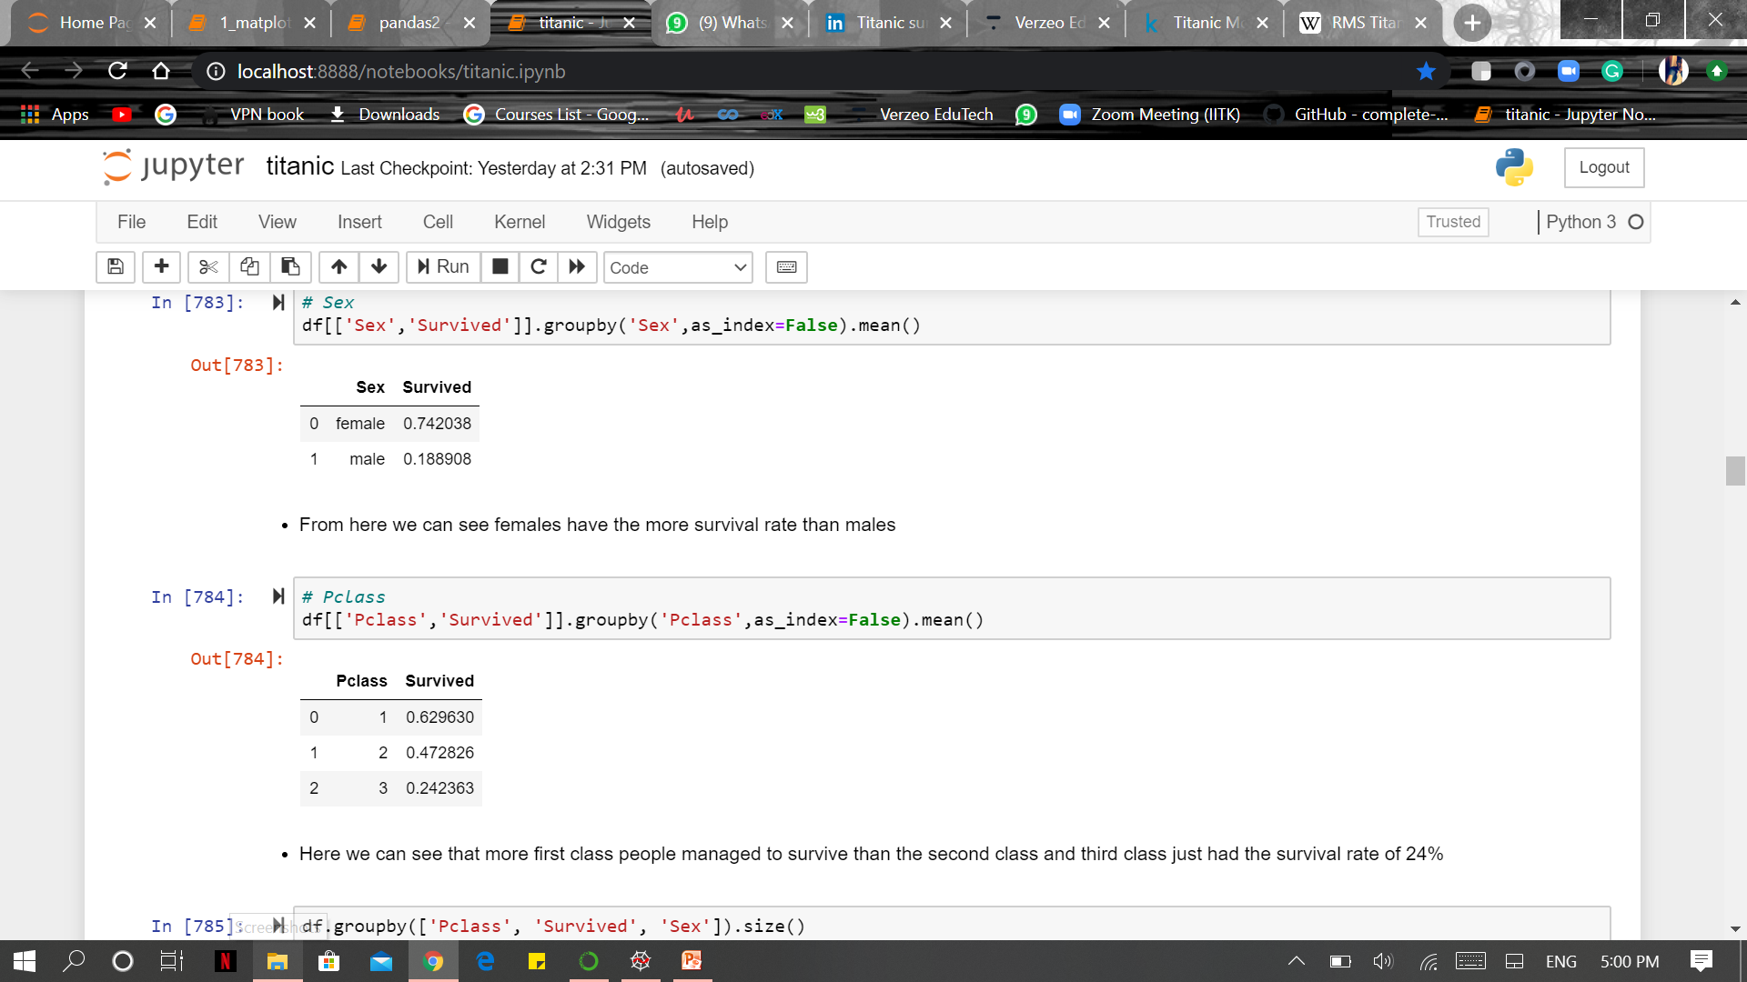

- Exploring the relationship between the features and target values

Slide 8
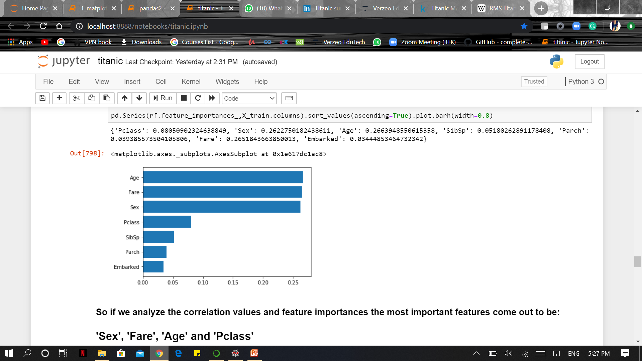
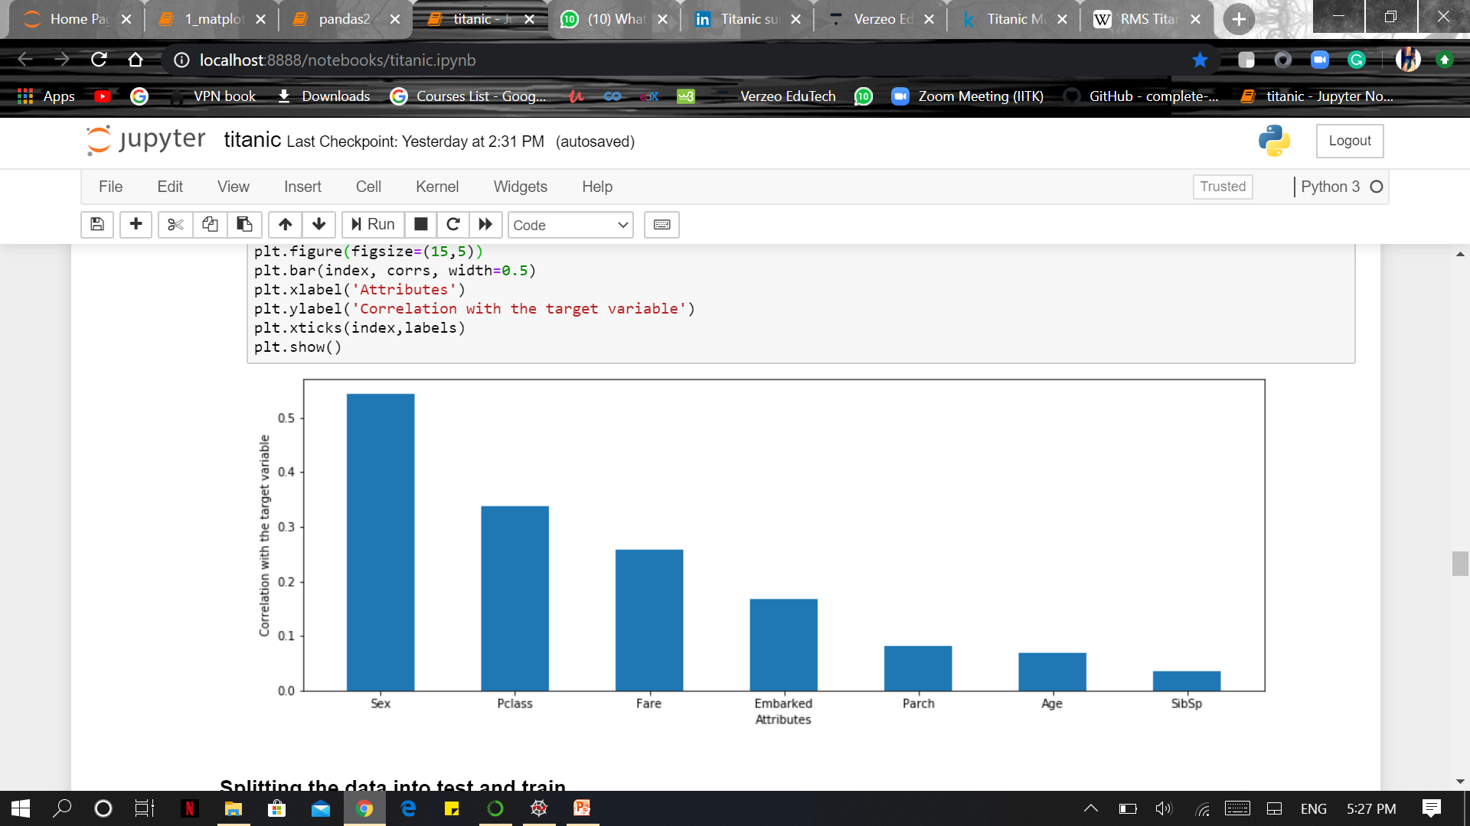
- Correlation and Feature Importance
After analysing the most important features can be :
'Sex', 'Fare', 'Age' and 'Pclass'

Slide 9
- Transforming and Splitting
To make our dataset ready for the model there are some prerequisites that need to be performed –
Label Encoding (Converting object type data into numerals)
Feature Scaling (Normalizing the range of the independent variables into a certain range)
Finally,
Splitting (Dividing the data into two parts, i.e., Training data and test data)
Training Data - A subset to train a model where you provide both independent and dependent variables.
Testing Data - A subset to test the trained model where you predict the target value and compare with the actual value

Slide 10
Third Step – Choosing and training the model
Machine Learning provides us with number of algorithms to train our datasets. After analyzing the data we realize that the target value is classified into either survived (1) or not survived (0). So in the training session I would be training my model using different classification models to get the best prediction model like:
Logistic Regression
Support Vector Machine Classification
K Nearest Neighbors Classification
Random Forest Classification

Slide 11
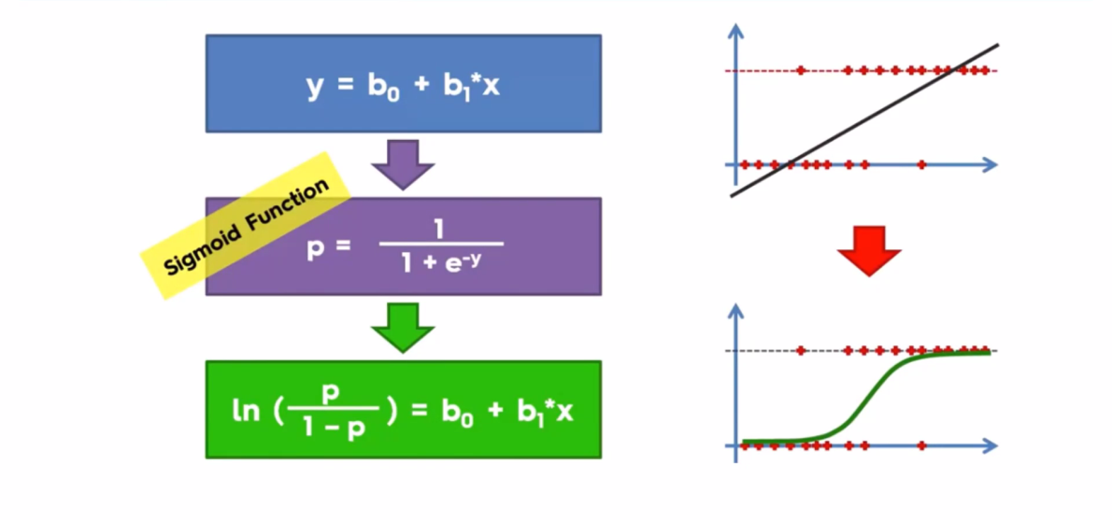
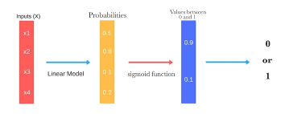
- Logistic Regression
Logistic regression is a statistical model that in its basic form uses a logistic function to model a binary dependent variable, although many more complex extensions exist. Mathematically, a binary logistic model has a dependent variable with two possible values, such as pass/fail which is represented by an indicator variable, where the two values are labelled "0" and "1".

Slide 12

- Support Vector Machine Classification
Support-vector machines are supervised learning models that analyse data used for classification and regression.
It’s a representation of the examples as points in space, mapped so that the examples of the separate categories are divided by a clear gap that is as wide as possible.
New examples are then mapped into that same space and predicted to belong to a category based on the side of the gap on which they fall.

Slide 13
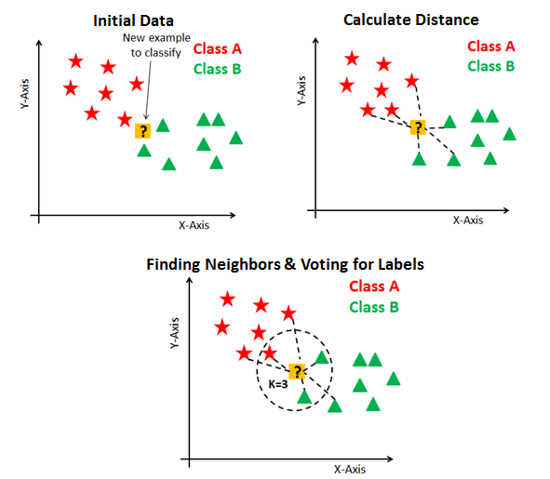
- K Nearest Neighbors Classification
The k-nearest neighbors algorithm (k-NN) is a non-parametric method used for classification and regression. In both cases, the input consists of the k closest training examples in the feature space.
In k-NN classification, the output is a class membership. An object is classified by a plurality vote of its neighbors, with the object being assigned to the class most common among its k nearest neighbors

Slide 14
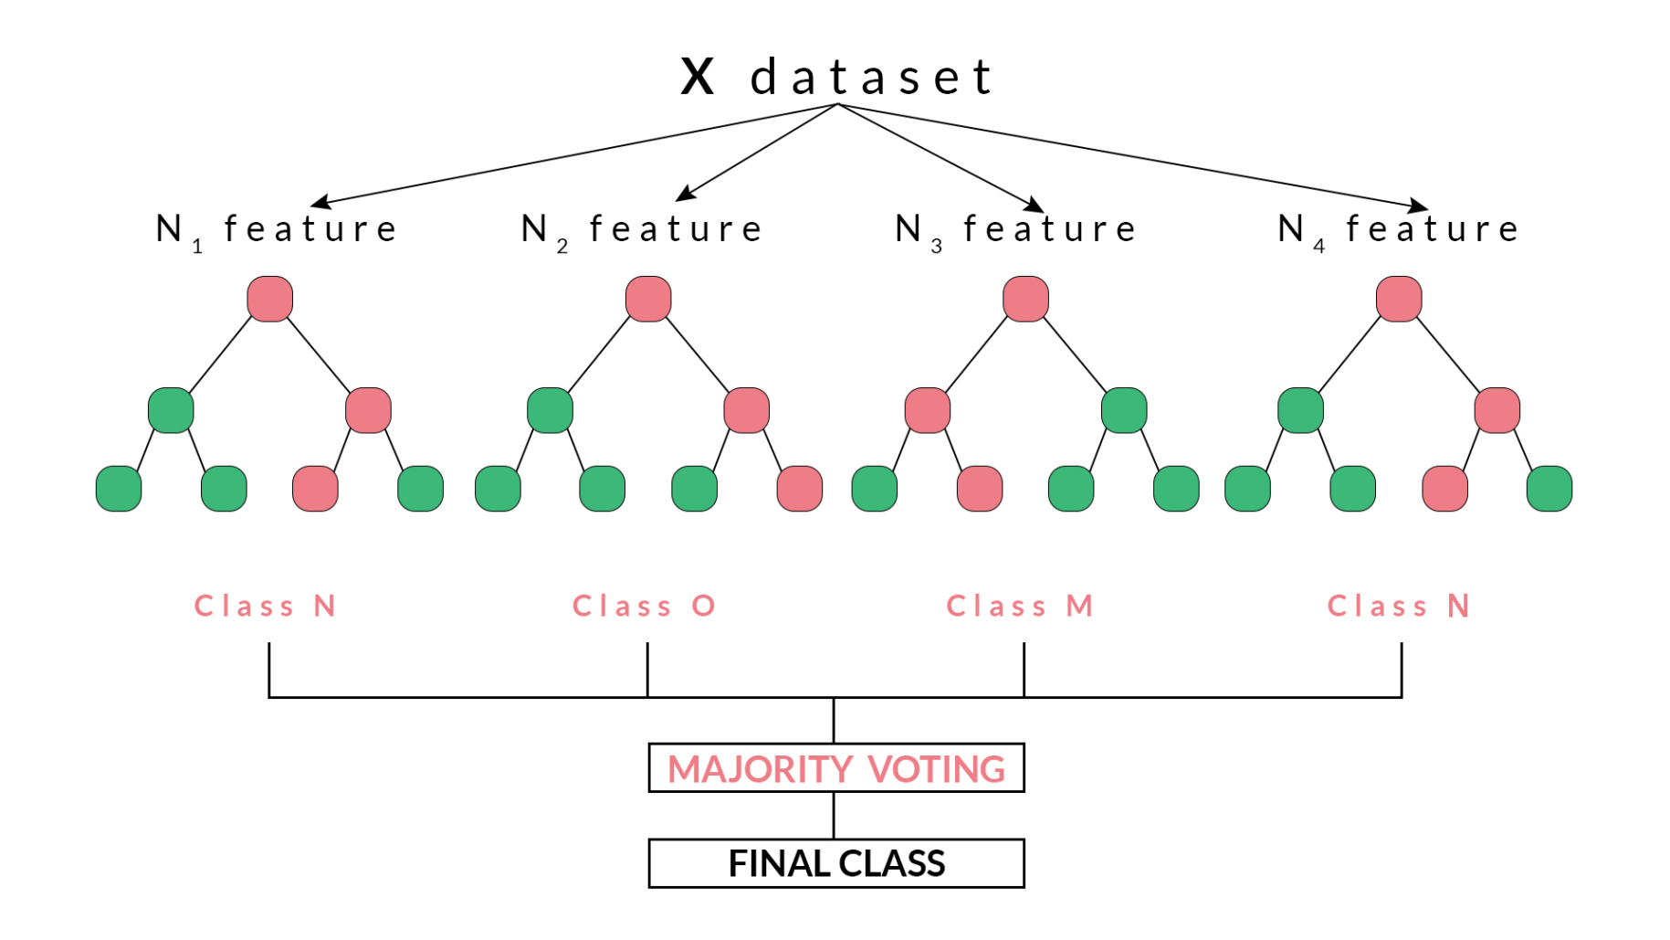
- Random Forest Classification

Slide 15
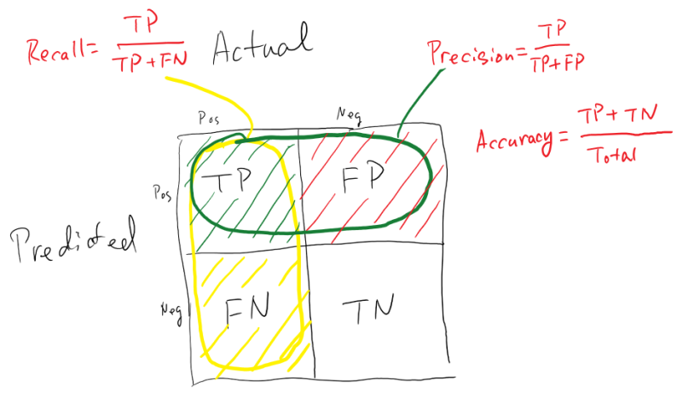
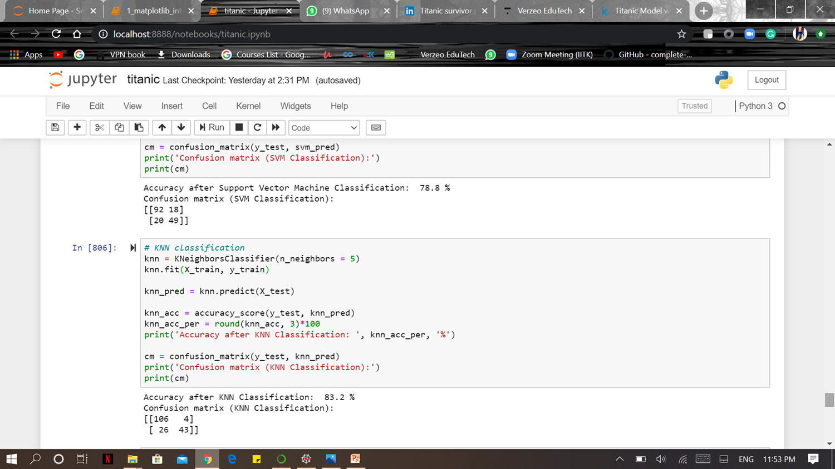

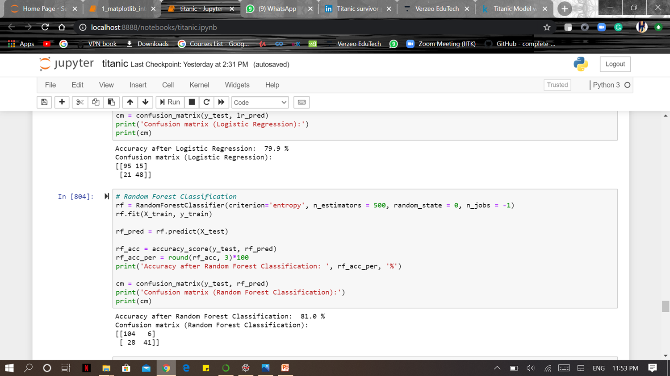

Fourth Step – Evaluating different models
CONFUSION MATRIX

Slide 16
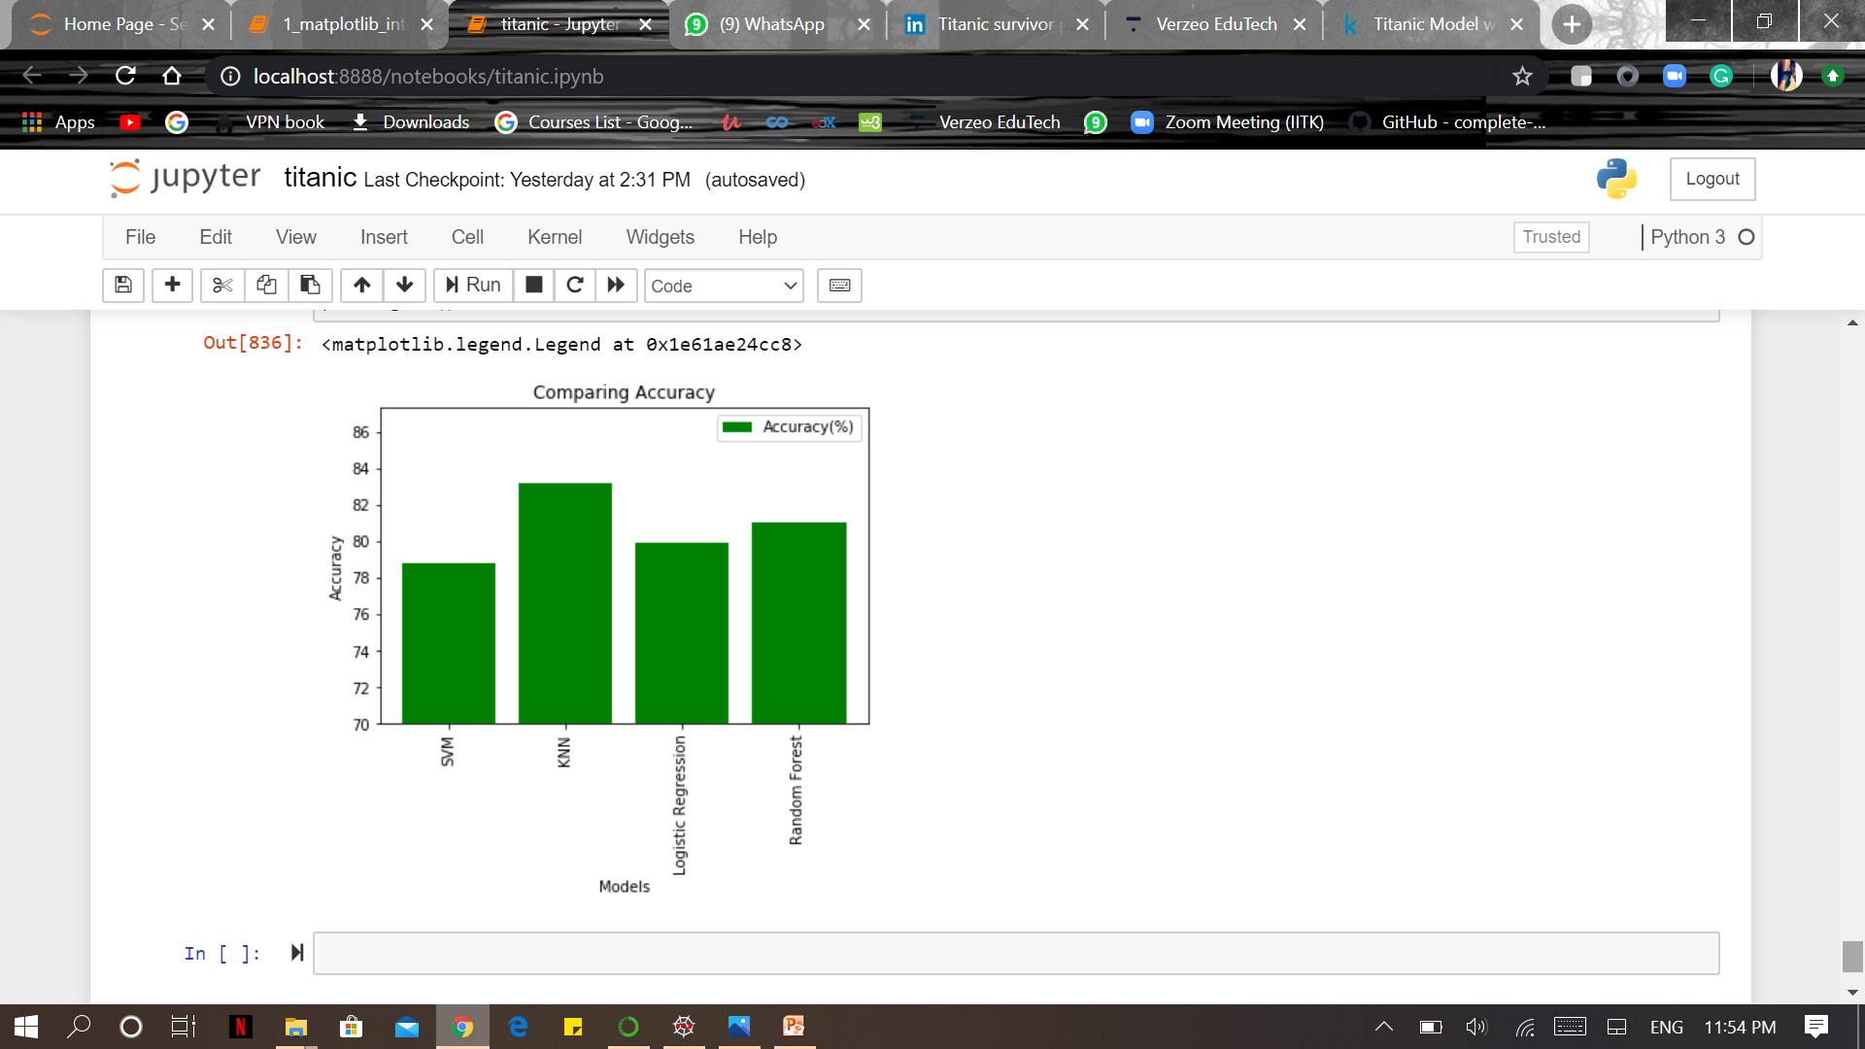
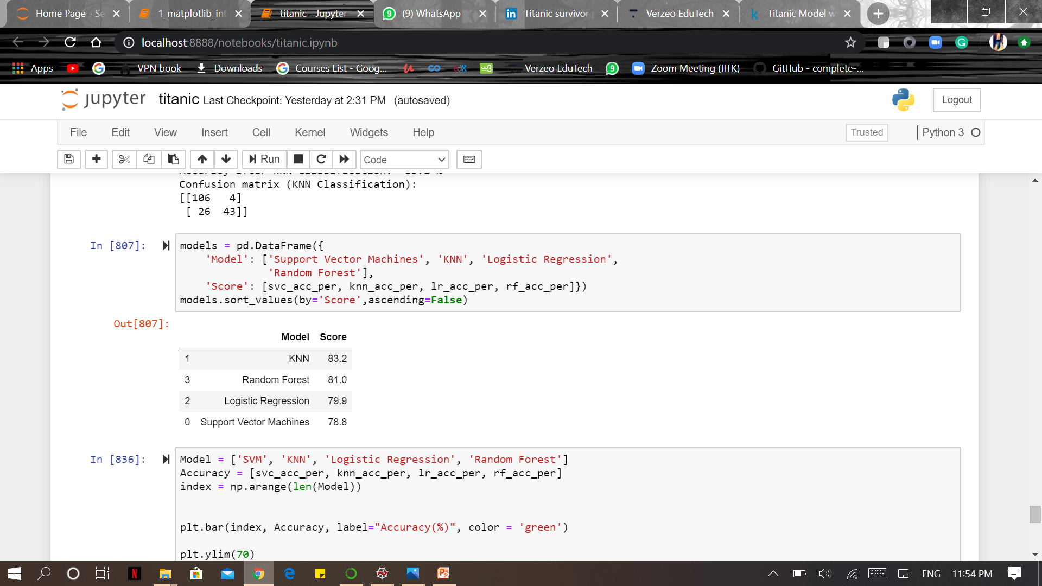
Comparing
Accuracies

Slide 17
Fifth Step – Tuning hyper-parameters
Sometimes the results you get after the prediction may not be the best ones, so hyper-parameter tuning has to be taken into consideration to get the optimal model architecture for the given model and it’s best to perform it on Cross-Validation Set.
This technique gives us the best values for the hyper-parameters which defines the model architecture. Hyper-parameters cannot be directly trained by the data so they can’t be counted as model parameters.
One of the most basic hyper-parameter tuning method is:
Grid search

Slide 18
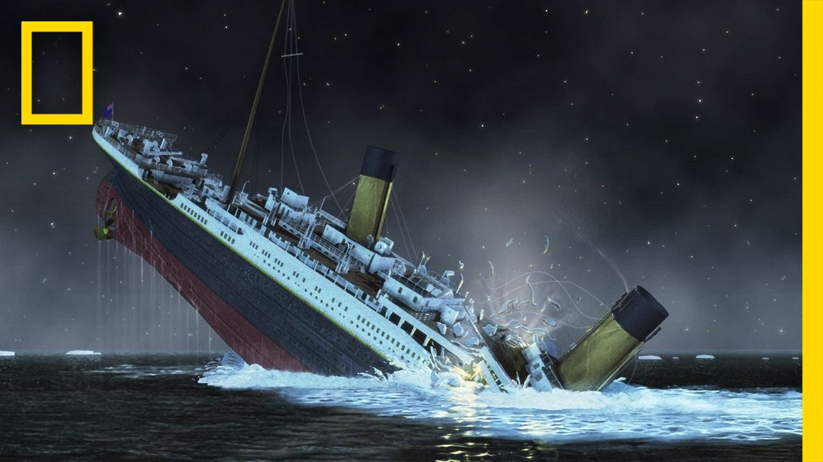
Conclusion
KNN Classification model brings us the highest accuracy of 83.2 than the other models used.
Women, first class passengers as well as people with a small family had a better chance at survival.

Slide 19
Efforts by
ANSHUL AGGARWAL
Ipynb File:
Email Id- anshulaggarwal24.aa@gmail.com

